Slide 1
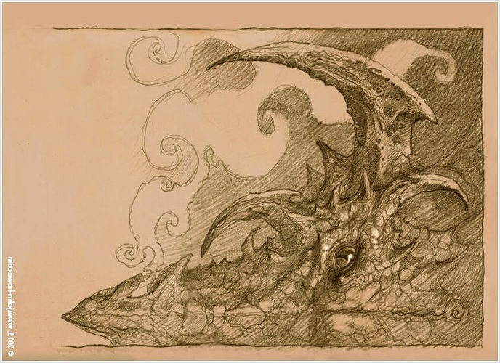
Essential Dragons
Beyond Tolkien’s Middle-earth
Sara Legard
Mythmoot 2 – December 15, 2013

Slide 2
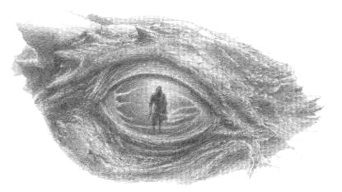
“real dragons, essential both to the machinery and the ideas of a poem or tale, are actually rare” –
J.R.R. Tolkien, Beowulf: The Monsters and the Critics

Slide 3
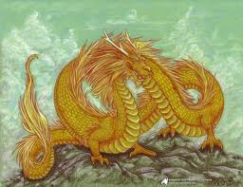
Tolkien’s Poetry and Stories with
Essential Dragons
“The Hoard” poem
Farmer Giles of Ham
“The Dragon’s Visit” poem
Roverandom

Slide 4
Tolkien’s Lectures with Dragon Topics
“Beowulf: The Monsters and the Critics,” British Academy lecture - 1936
“On Dragons,” Oxford University Museum of Natural History lecture - 1938
“On Fairy-stories,” Andrew Lang Lecture - 1939

Slide 5
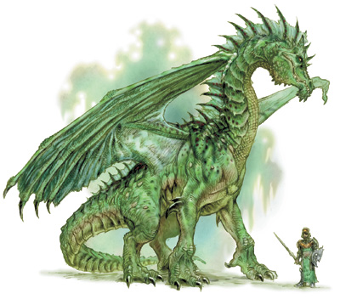
Tolkien’s criteria for dragons in northern European tales:
Dragon as a mortal denizen of the material world;
Dragon as a personification of malice, destruction, and cruel Fortuna;
Dragon as a personification of greed and miserliness;
Dragon in single-combat, testing a hero’s courage; and
Dragon as indicator of Faërie or an Other-world.

Slide 6
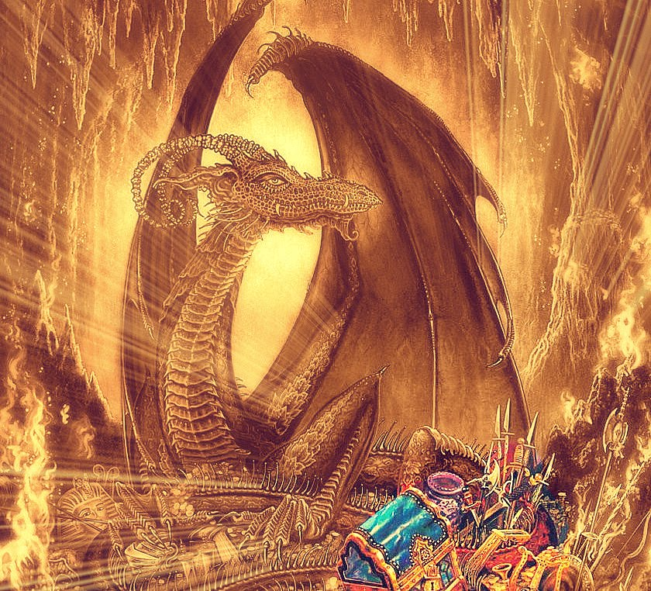
“The Hoard”
“Iúmonna Gold Galdre Bewunden,” – 1923, 1937
“The Hoard” – 1962
Dragon as a mortal denizen of the material world
Dragon as a personification of malice, destruction, and cruel Fortuna
Dragon as a personification of greed and miserliness
Dragon in single-combat, testing a hero’s courage
Dragon as indicator of Faërie or an Other-world

Slide 7
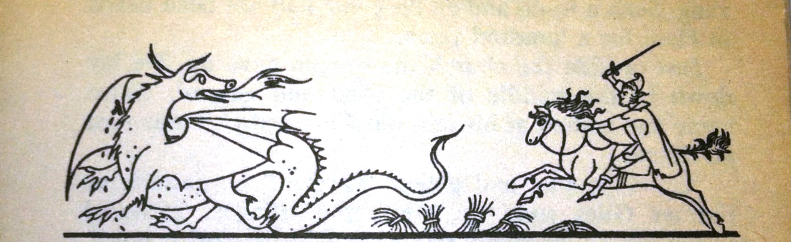
Farmer Giles of Ham
Read to Oxford literary society 1938
Published 1949, 1962
Chrysophylax dragon as a mortal denizen of the material world
Dragon as a personification of malice, destruction, and cruel Fortuna
Dragon as a personification of greed
Dragon in single-combat, testing a hero’s courage
Dragon as indicator of Faërie or an Other-world

Slide 8
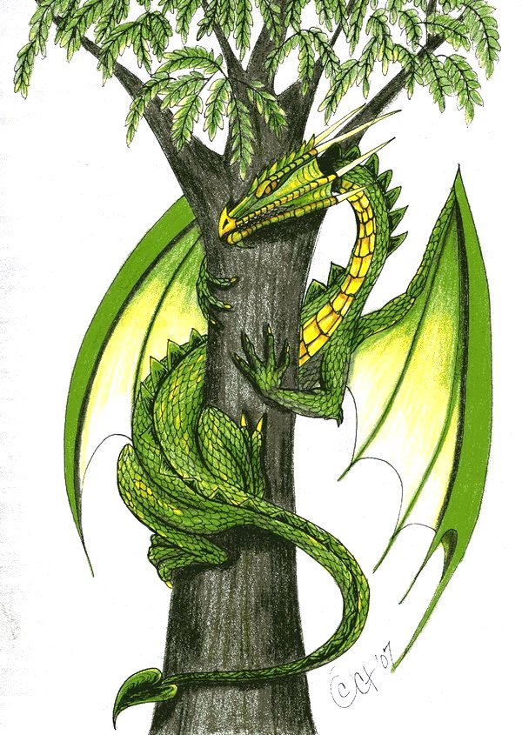
“The Dragon’s Visit”
Tales and Songs of Bimble Bay, Oxford Magazine - 1937
Winter’s Tales for Children 1 – 1965
Dragon as a mortal denizen of the material world
Dragon as a personification of malice, destruction, and cruel Fortuna
Dragon as a personification of greed and miserliness
Dragon in single-combat, testing a hero’s courage
Dragon as indicator of Faërie or an Other-world

Slide 9
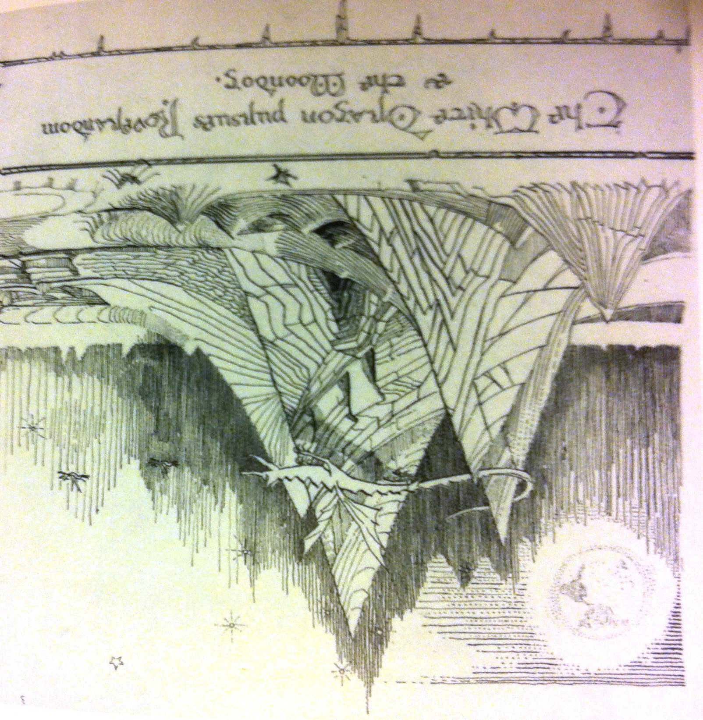
Roverandom
Oral story – 1925, 1927
Published posthumously – 1998
Two essential, mythic dragons: the Great White Dragon of the Moon and Sea-serpent
Dragon as a mortal denizen of the material world
Dragon as a personification of malice, destruction, and cruel Fortuna
Dragon as a personification of greed and miserliness
Dragon in single-combat, testing a hero’s courage
Dragon as indicator of Faërie or an Other-world

Slide 10
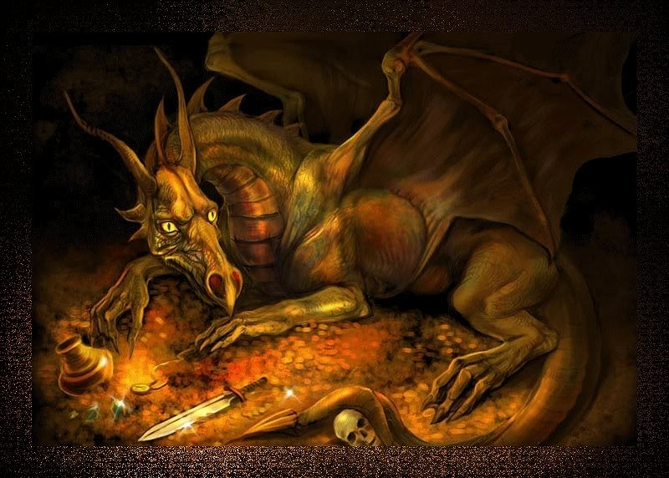
The Lectures
Beowulf: The Monsters and the Critics, 1936
On Dragons, 1938
On Fairy-stories, 1939
The Criteria
Dragon as a mortal denizen of the material world;
Dragon as a personification of malice, destruction, and cruel Fortuna;
Dragon as a personification of greed and miserliness;
Dragon in single-combat, testing a hero’s courage; and
Dragon as indicator of Faërie or an Other-world.

Slide 11
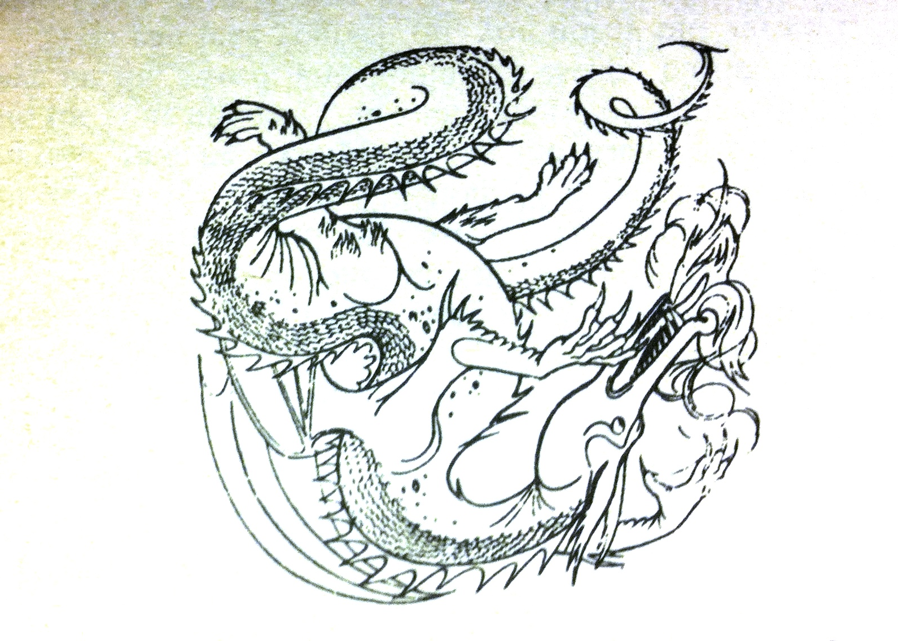
Tolkien’s Poetry and Stories with
Essential Dragons
“The Hoard” poem
Farmer Giles of Ham
“The Dragon’s Visit” poem
Roverandom

Slide 12
References
Artists: John Howe, facebook 2013; Alan Lee, The Children of Hurin 2007; Rachael Eve Lachance ,elfwood.com 2009; Unknown, accessed draconika.com 2013; Unknown, accessed patrickoscheen, wordpress.com 2013; Pauline Baynes The Tolkien Reader 1966; Cyntht, deviantart.com 2007; J.R.R.Tolkien Roverandom 1998; Unknown , accessed poetry.rapgenius.com /Beowulf-chapter-32 2013.
Atherton, Mark. There and Back Again: J.R.R.Tolkien and the Origins of the Hobbit. New York: I.B. Tauris, 2012. Print.
Beowulf, A Dual-Language Edition. Tr. Howell D. Chickering, Jr. New York: Random House, 1977. Print.
Byrne, Dierdre. “Dragons: Ancient Creatures in Modern Times.” Inaugural Lecture, University of South Africa, Mar. 3, 2011. Web, accessed 7/26/2013.
Carpenter, Humphrey. J.R.R. Tolkien: A Biography. Boston: Houghton Mifflin, 1977. Print.
Croft, Janet Brennan. “Farmer Giles of Ham,” in J.R.R.Tolkien Encyclopedia: Scholarship and Critical Assessment. Ed. Michael D.C. Drout. New York: Routledge, Taylor & Francis, 2007. Web, accessed 7/27/2013.
Rateliff, John D. The History of The Hobbit. Boston: Houghton Mifflin, 2007. Print.
---. “Review of Tales Before Narnia: The Roots of Modern Fantasy and Science Fiction”. Mythlore 107/108, Fall/Winter 2009. Mythopoeic Society website, accessed 7/28/2013
Shippey, Tom. J.R.R. Tolkien: Author of the Century. Boston: Houghton Mifflin, 2007. Print.
---. Roots and Branches: Selected Papers on Tolkien. Ed. Thomas Honegger. Walking Tree Publ, 2007. Print
Tolkien, J.R.R. The Annotated Hobbit. Rev, annot by Douglas A. Anderson. Boston: Houghton Mifflin, 2002. Print.
---. The Legend of Sigurd and Gudrún. Ed. Christopher Tolkien. Boston: Houghton Mifflin, 2009. Print.
---. Letters from Father Christmas. Rev. edition. Ed. Baillie Tolkien. Boston: Houghton Mifflin, 2004. Print.
---. The Letters of J.R.R. Tolkien. Ed. Humphrey Carpenter. New York: Houghton Mifflin, 1981. Print.
---. The Monsters and the Critics and Other Essays. Ed by Christopher Tolkien. London: HarperCollins, 1983. Print.
---. “Mythopoeia.” Ver. circa 1931. (Class handout for “The Making of Myth: C.S. Lewis and J.R.R. Tolkien,” Mythgard Institute, February 2012).
---. Roverandom. Ed. Christina Scull and Wayne G. Hammond. New York: Houghton Mifflin, 1998. Print.
---. The Tolkien Reader. New York: Ballantine Books, 1966. Print.
---. The Treason of Isengard: The History of Middle-earth, Volume VII. Ed. Christopher Tolkien. Boston: Houghton Mifflin, 1989. Print.

